Slide 1
Bayesian Classifier Implementation
Amanda Braun and Riley Herman

Slide 2
Flags and Religion
First use of flags as national symbols probably religiously influenced (Scotland in 832; Japan in the late 600s)
Obvious in cases of state religion (England, Pakistan, Bhutan, etc.)
Religious nations can influence the flag choices of nations without a state religion (Nordic countries, Singapore)
Flags are an imperfect indicator of religious status

Slide 3
Bayesian Probability
P(A|B) = ( P(B|A) * P(A) ) / P(B)
Where:
· P(A) – Prior probability: the initial probability before new evidence is introduced
· P(A|B) – Posterior probability: the resulting probability after new evidence
· P(B|A) – Likelihood: the probability of new evidence under the hypothesis
· P(B) – Normalizing constant: the probability of new evidence under any hypothesis

Slide 4


Naive Bayes
Naïve Bayes assumes conditional independence of features
Simplified form - normalizing constant is not used
Different implementations of Naïve Bayes vary in how the likelihood, P(fn | class), is calculated
P(class | f1,..., fn) is calculated for each class and the predicted class is chosen by selecting the maximum

Slide 5
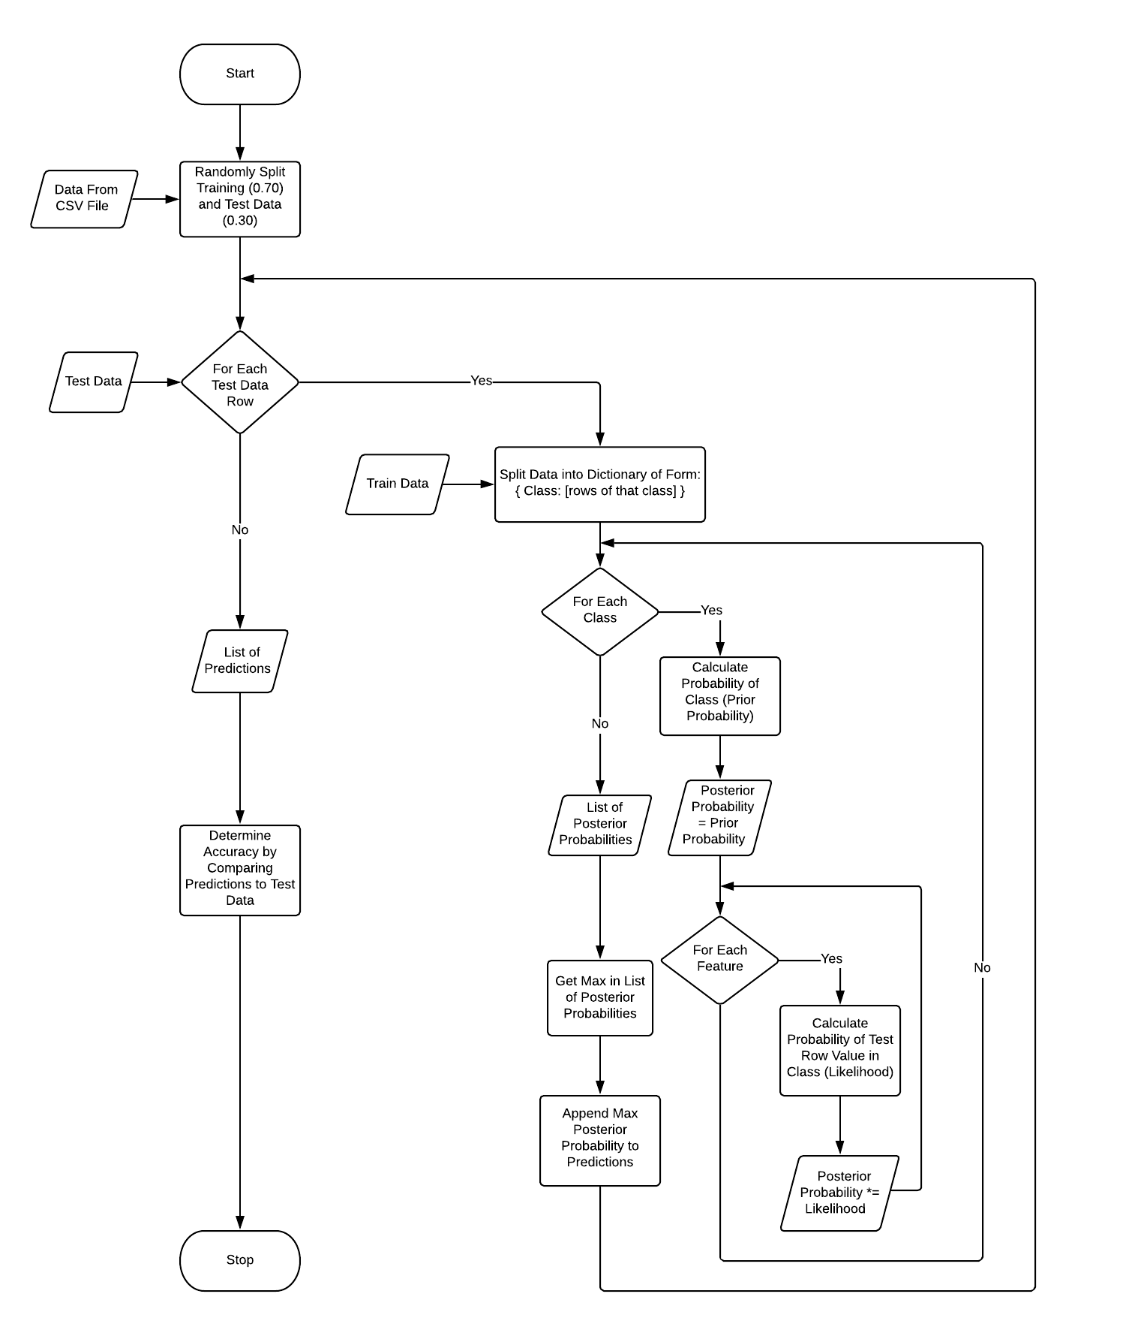
Naive Bayes Algorithm
Read input data
Split data into training and testing sets
Calculate Probabilities
Select predicted class using probabilities
Calculate accuracy of predictions

Slide 6
Probability Calculations
Prior Probability: in the training set, divide the number of rows of a specific class by the total number of rows
Likelihood: for each feature divide the number of rows with that feature value by the total number of rows
Posterior Probability: prior probability multiplied by the likelihood of each test row feature
Classification: select the maximum value in the set of posterior probabilities

Slide 7
Data
Modified version of (UCI Machine Learning Repository, 1990)
Changed the religious categories to Catholic (20.9%), Other Christian (37.2%), Muslim (20.0%), Buddhist (4.7%), Hindu (1.9%), Distinct Cultural Beliefs (13.0%), Other/Non-religious (2.3%)
Flag attributes include: name, landmass, zone, area, population, language, bars, stripes, colours, circles, crosses, saltires, quarters, suns/stars, crescent moons, triangles, icons, animals, and text

Slide 8
Inputs and Outputs
Inputs: Data (CSV), number of trials, which column in the data is to be predicted
Outputs: Max/Min/Avg accuracy of the predictions, as well as the same info for random guessing and the benchmarking algorithm

Slide 9

Design Decisions
Python 3.6.7
Used Python csv, time, and random libraries
Additive smoothing (P(false) = 0.0000000001)
70% training data/30% testing data

Slide 10
Testing Algorithms
Random Algorithm
Randomly assign a class to each test row
Benchmark Algorithm
Naïve Bayes classifier using the Sci-kit Machine Learning Library and Pandas Data Analysis Library
Basically a black box that handles all computation
Sci-kit Gaussian Naïve Bayes and Multinomial Naïve Bayes models were tested. Gaussian Naïve Bayes had the best accuracy and was selected as the model for benchmarking

Slide 11
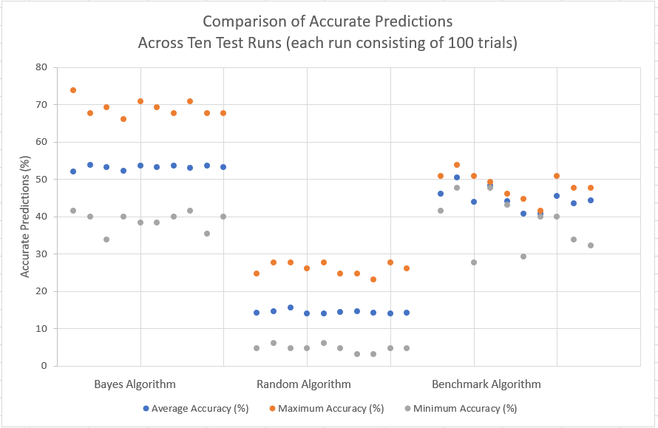
Analysis
Average accuracy across all test runs:
Bayes’ algorithm 53.1431%
Random algorithm 14.3846%
Benchmark algorithm 44.7631%

Slide 12
References
Bartram, G. (2001). Proceedings of the XIX International Congress of Vexillology. York, UK:Fédération internationale des associations vexillologiques.
Downey, A. B. (2012). Think Bayes Bayesian statistics made simple; Version 1.0.5. Needham, MA: Green Tea Press.
Dyer, H. (1909). Japan in World Politics: A Study in International Dynamics. Glasgow: Blackie & Son Limited.
Fahrmeir, L. & Kneib, T. (2011). Bayesian Smoothing and Regression for Longitudinal, Spatial and Event History Data. OUP Catalogue. Oxford: Oxford University Press.

Slide 13
References
Géron, A. (2019). Hands-on Machine Learning with Scikit-Learn, Keras, and TensorFlow, 2nd Edition. Retrieved March 24, 2019, from https://learning.oreilly.com/library/view/hands-on-machine-learning/9781492032632/ch01.html
Guyon, I. (1996). A Scaling Law for the Validation-Set Training-Set Size Ratio. Murray Hill, USA: AT&T Bell Lab.
Hunt, M. H. (2015). The World Transformed: 1945 to the Present (2nd ed. revised). Oxford: Oxford University Press.
Langley, P., Iba, W., & Thompson, K. (1992). An Analysis of Bayesian Classifiers. Moffett Field, USA: NASA Ames Research Centre, AI Research Branch.

Slide 14
References
Python Software Foundation. (n.d. a). 9.6. random - Generate pseudo-random numbers. Retrieved from https://docs.python.org/3.6/library/random.html
Python Software Foundation. (n.d. b). 14.1. csv - CSV File Reading and Writing. Retrieved from https://docs.python.org/3.6/library/csv.html
Python Software Foundation. (n.d. c). 16.3. time - Time access and conversions. Retrieved from https://docs.python.org/3.6/library/time.html
UCI Machine Learning Repository. (1990). Flags Data Set [Data file]. Retrieved from https://archive.ics.uci.edu/ml/datasets/Flags
Wackerly, D. D., Mendenhall III, W., & Scheaffer, R. L. (2008). Mathematical Statistics with Applications (7th ed.). Belmont, CA: Thomson Brooks/Cole.

